Slide 1
Advanced Web programming
Lec-14
Unit 3
State Management

Slide 2
Outline
State Management : Understanding the Problem of State,
Using View State,
Transferring Information Between Pages,
Using Cookies,
Managing Session State,
Configuring Session State,
Using Application State,
Comparing State Management Options

Slide 3
Hyper Text Transfer Protocol is the base ,is the core part or the foundation of our World Wide Web.
It basically makes use of the TCP Protocol for communicating with the server. A specific port is being used by this protocol while communicating with the server.
The ASP.NET Engine processes the request and sends a response back to the client in an HTML format. Once again the HTTP protocol is relevant; the HTTP protocol takes the response and sends it to the client, thus the response is shown in the client's browser.
The HTTP Protocol, which is also called a "Request - Response" Protocol, acts like a bridge between the client and the server.

Slide 4
Whenever the user sends a request to the server, the server first locates the page and checks who will process the request.
Then it creates an App Domain which is a space in the memory / Memory Unit which creates a Hosting Environment.
It then creates 4 different Objects like:
Http Response Object
Http Request Object
Http Context Object
Http Application Object
These objects then process the request and sends a response to the user in HTML format.
The App Domain is created only once for each Website or an application. The Http Application Object is also created only once. The creation happens when the user requests a website for the first time.

Slide 5
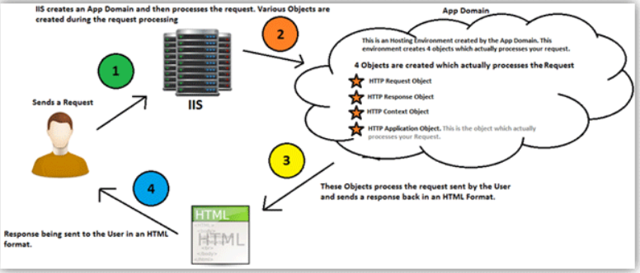

Slide 6
State Management can be defined as the technique or the way by which we can maintain / store the state of the page or application until the User's Session ends.
State Management Types
Client-side Management
Server-side Management
State Management Techniques
Client-side Techniques
View
Hidden
Cookies
Control State
Query Strings

Slide 7
Server-side Techniques
Session State
Application State
State Management can be defined as the technique or the way by which we can maintain / store the state of the page or application until the User's Session ends.
Browsers are generally stateless.
Stateless means, whenever we visit a website, our browser communicates with the respective server depending on our requested functionality or the request. The browser communicates with the respective server using the HTTP or HTTPs protocol.
When we visit that website again after closing our web browser, In this case HTTP/HTTPs doesn't remember what website or URL we visited, or in other words we can say it doesn't hold the state of a previous website that we visited before closing our browser, that is called stateless.

Slide 8
Hyper Text Transfer Protocol (HTTP) is a stateless protocol. When the client disconnects from the server, the ASP.NET engine discards the page objects. This way, each web application can scale up to serve numerous requests simultaneously without running out of server memory.
However, there needs to be some technique to store the information between requests and to retrieve it when required. This information i.e., the current value of all the controls and variables for the current user in the current session is called the State.
ASP.NET manages four types of states:
View State
Control State
Session State
Application State

Slide 9
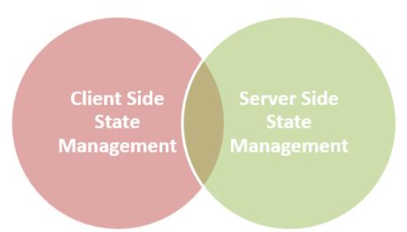
HTTP is a stateless protocol. It just cleans up or we can say removes all the resources/references that were serving a specific request in the past. These resources can be:
Objects
Allocated Memory
Sessions ID's
Some URL info and so on.
State Management Types
In ASP.NET there are the following 2 State Management methodologies:

Slide 10

Client-Side State Management
Whenever we use Client-Side State Management, the state related information will directly get stored on the client-side. That specific information will travel back and communicate with every request generated by the user then afterwards provides responses after server-side communication.
This architecture is something like the following,

Slide 11

Server-Side State Management
Server-Side State Management is different from Client-Side State Management but the operations and working is somewhat the same in functionality. In Server-Side State Management all the information is stored in the user memory. Due to this functionality there is more secure domains at the server side in comparison to Client-Side State Management.
The structure is something like the following,

Slide 12
Client-side | Techniques
Client-Side State Management techniques are,
View State
Hidden field
Cookies
Control State
Query Strings

Slide 13
View State View State can be used to maintain the State at a page level.
The term "Page Level" means that the information is being stored for a specific page and until that specific page is active (i.e. the page which is being currently viewed by the user).
Once the user is re-directed or goes to some other page, the information stored in the View State gets lost. It basically makes use of a "Dictionary Object" to store data, which means that the information is stored in a key and value pair.
It stores this information in a Hidden field on the page itself in a hashed format.
A View State can store a string value only of a specific length. If the length is exceeded then the excess information is stored in another hidden field.

Slide 14
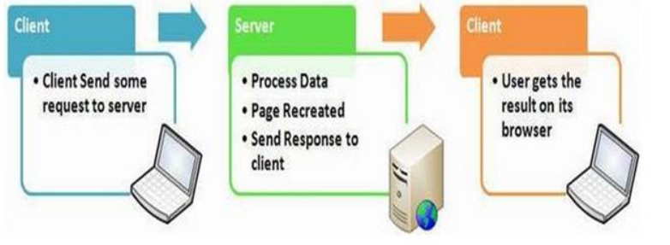
View State
In general we can say it is used for storing user data in ASP.NET, sometimes in ASP.NET applications the user wants to maintain or store their data temporarily after a post-back.. In this case VIEW STATE is the most used and preferred way of doing that.
This property is enabled by default but we can make changes depending on our functionality, what we need to do is just change the EnableViewState value to either TRUE for enabling it or FALSE for the opposite operation.

Slide 15
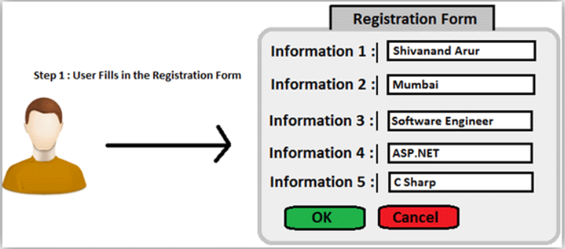
Using a View State is quite simple. In fact, it is the default way for storing the page or the control's information.
Typically the View State is used, when we want a user to be re-directed to the same page and the information being added by the user remains persistent until the user is on the same page.
The KeyValuePair class stores a pair of values in a single list with C#.
Example A user fills in a Registration Form.

Slide 16

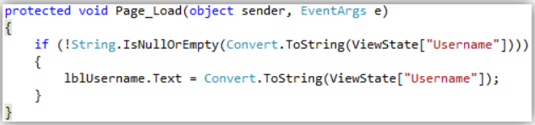
Storing Value in a View State
"Username" is the key and the value is the text being inputted by the user (txtFName.Text).
Retrieving Value from a View State
Retrieving the value from the View State, in the Page Load event of a page by first checking if the View State is not empty or null and then assigning its value to a Label.

Slide 17
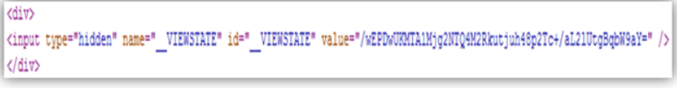
View State Information is stored in a Hashed Format
At the page source, the View State stores the value in Hashed Format.

Slide 18
View State Settings
The view state could be customizable i.e. enabled or disabled for:
The entire application by setting the EnableViewState property in the <pages> section of web.config file.
A page by setting the EnableViewState attribute of the Page directive, as <%@ Page Language="C#" EnableViewState="false" %>
A control by setting the Control.EnableViewState property.
It is implemented using a view state object defined by the StateBag class which defines a collection of view state items. The state bag is a data structure containing attribute value pairs, stored as strings associated with objects.

Slide 19
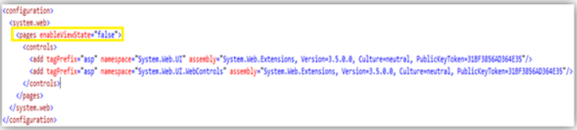
View State is customizable, that we can apply settings to a View State to store a value at various levels.
We can set the View State at various levels like:
1. Setting View State at Application Level
If we do not want our pages in the Application to use view state, then we can disable or enable it in the web.config file, as shown in the image below.

Slide 20
2. Setting View State at Page Level If we do not want a specific page to use View State, then we can disable or enable it in the @ Page Directive which is the first line of our aspx page.
3. Setting View State at Control Level - If we do not want a specific control to use View State, then we can disable or enable it at a Control Level as follows:

Slide 21
The features of view state are:
It is page-level State Management
Used for holding data temporarily
Can store any type of data
Property dependent
Advantages of using a View State
It is very simple to use.
Data is stored in hashed format and hence a layman won't be able to understand the value of the View State (It still can be hacked by Hackers, so to make it more secure we should try to store the value in an encrypted format.).
It is customizable.

Slide 22
Disadvantages of using a View State
Information is not encrypted, so it can be easy for a Hacker to get its value.
Cannot be used to store sensitive data (eg: Passwords, Credit Card Pins, etc).
Might make a page heavy if lots of data is stored in View State.

Slide 23
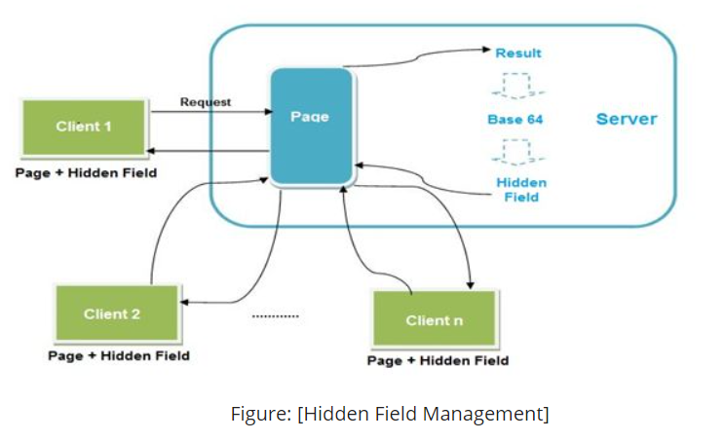
Hidden Field
A hidden field is used for storing small amounts of data on the client side. In most simple words it's just a container of some objects but their result is not rendered on our web browser. It is invisible in the browser.
It stores a value for the single variable and it is the preferable way when a variable's value is changed frequently but we don't need to keep track of that every time in our application or web program.

Slide 24

ASP.NET provides a server control called "Hidden Field" which can be used to store a value at a page level, which is similar to a View State. The value of the Hidden Field is sent along in the HTTP Form Collection along with the value of other controls.
Example Take the same example of the User filling an online registration form. Setting Value to a Hidden Field

Slide 25
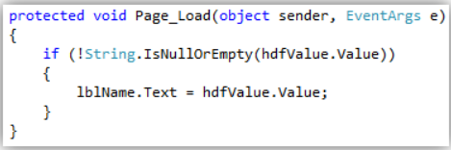
Information Here I am setting a value to a Hidden field, as shown in the image above. I am taking input from the User (txtUsername.Text) and assigning it to the Hidden Field's Value property. It basically stores only 1 value in its property. Retrieving Value from a Hidden Field
As you can see, I am retrieving a value from the value in the Hidden field and assigning it to a label. The Hidden Field's "Value" property returns a string by default. If you want an integer value, then you will have to convert it explicitly. A Hidden Field stores a value at a Page Level If you look at the page source after assigning a value to a Hidden Field, then you will see that it stores the value on the page itself. Once the user is redirected to some other page, then the value is lost.

Slide 26
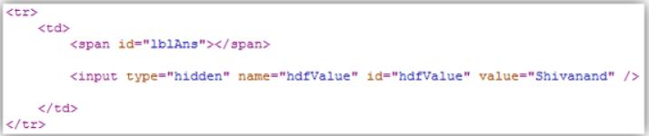
We’ve passed "Shivanand" as a value from my textbox and assigned that value to a hidden field.
Advantages
Very simple to use.
Hidden Fields store the value in the page itself, hence do not use server resources.
Disadvantages
Will make a page heavy, if too many Hidden Fields are used to store data.
Cannot store sensitive data, as the value that is stored is neither hashed, nor encrypted.

Slide 27

Query String A Query String is a string which is appended to the end of the Page URL. It is very simple to use and can be used to send data across pages. It stores information in a key - value pair. A "?" signature is used to append the key and value to the page URL.
Way to pass a value using Query String
This preceding code will send the Username to another page and use that value on that page
We should never send sensitive data using Query String, since the data that is being sent can easily be tampered with by anybody.
If you still want to send information using Query String, then encrypt the data using any ASP.NET Encryption technique so the data cannot be tampered with.

Slide 28
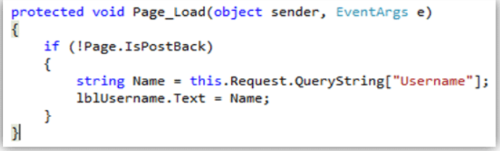
Way to read Query String value
To read the value of the query string, you should use the Request Object as shown in the image above. You can send multiple parameters in the query string along with its respective value. For sending multiple parameters, you can separate the parameters using the "&" delimeter.

Slide 29
Cookies
ASP.Net provides another way of state management, which is by using Cookies. Cookies are one of the best ways of storing information. It is nothing but a text file which is stored on the client's machine.
When the user sends a request to the server, the server creates a cookie and attaches a header and sends it back to the user along with the response.
The browser accepts the cookie and stores it at a specific location on the client's machine. Even large sites like Gmail, Facebook, Yahoo use cookies.
Cookies are just used for the sake of the user's identity matching as it only stores information such as sessions id's, some frequent navigation or post-back request objects.

Slide 30
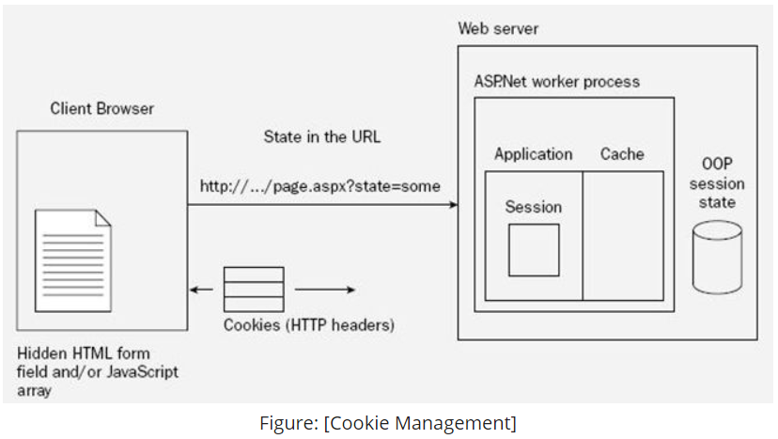
Cookie management

Slide 31

There are 2 ways of assigning / storing values in cookies.
Using the Request Object
use of the Request object. The Cookies property of the HTTPResponse Object and the HTTPRequest Object can be used to assign values to the Cookies Collection and get values back from the Collection. We can also store multiple values in a cookie.

Slide 32
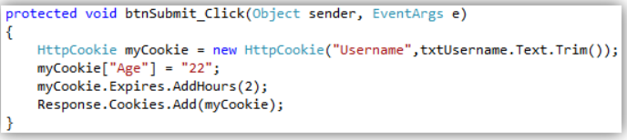
2. Using the HTTPCookies Object
Another way of adding values to a cookie is using the "HTTPCookie" class. Its constructor takes either 1 or 2 parameters.
If you want your cookie to expire after a specified time then you can even set the expiration date for that cookie. And the last line "Response.Cookies.Add(myCookie)" will add that cookie to the Cookies Collection.
Trim() is a string method. This method is used to removes all leading and trailing white-space characters from the current String object.

Slide 33
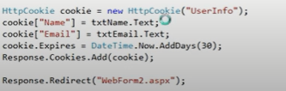
Cookie Types
1. Persistent Cookie
Persistent Cookies are Permanent Cookies stored as a text file in the hard disk of the computer.

Slide 34
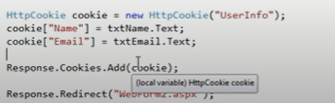
Non-Persistent Cookie
Non-Persistent cookies are temporary. They are also called in-memory cookies and session-based cookies. These cookies are active as long as the browser remains active, in other words if the browser is closed then the cookies automatically expire.
Features of cookies are:
Store information temporarily
It's just a simple small sized text file
Can be changed depending on requirements
User Preferred
Requires only a few bytes or KBs of space for creating cookies

Slide 35
Advantages
Very easy to use.
Stored on the client's machine, hence no server resources are utilized.
Disadvantages
A user can disable cookies using browser settings.
Since the cookies are stored on the client's machine, there are chances that if the client's machine is hacked then the hacker can view these cookie values. Hence we should not store sensitive information in cookies.

Slide 36
To be continued….

